Slide 1

Ticketing System Implementation
Michael, ||||||||||||, ||||||||||||, ||||||||||||

Slide 2

Project
Goal
Notes:
Researching, selecting, implementing a ticketing system based on requirements outline

Slide 3
Requirements
Must Have
Nice to Have
Container Support
Free (Open Source)
Self-Hosted
Categorization of Tickets
KBA Support
Dashboard
Reporting
Prioritization
Security
Fine-grained Permission assigning
Keyword Searching
Bulk User creation
API Support
Email Integration
Official Documentation
Non limiting caps (for users, tickets, etc.)
Bulk Ticket resolution
Notes:
Top requirements are: Free (open source) and self-hosted to avoid fees
They were acquired via various means such as talking directly to the project managers

Slide 4
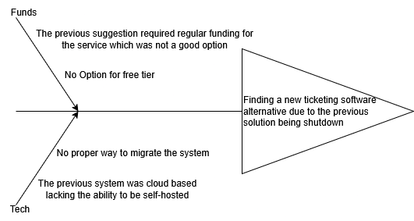
Root cause analysis
Notes:
Performing some rudimentary business analysis such as a...

Slide 5
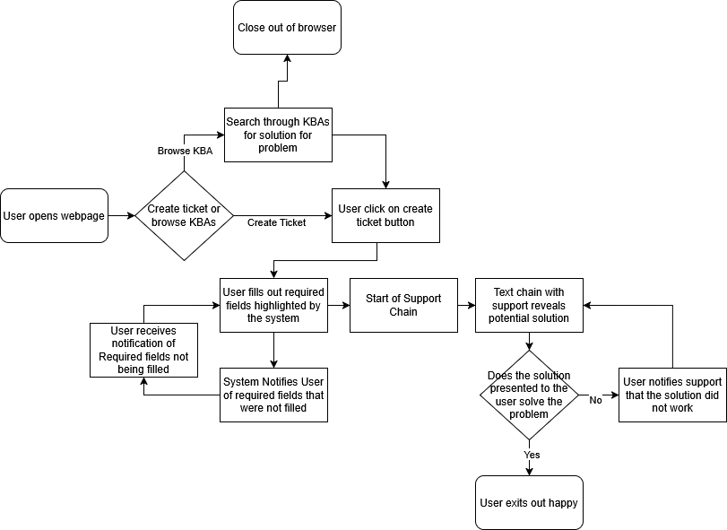
Workflow – User Experience - General
Notes:
We are looking for a general workflow to look like this for ...

Slide 6
Notes:
We are looking for a general workflow to look like this for ...

Slide 7
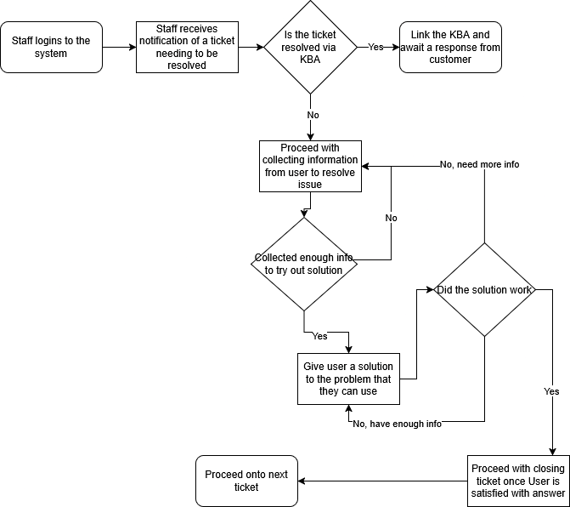
Workflow – Support Experience - General

Slide 8
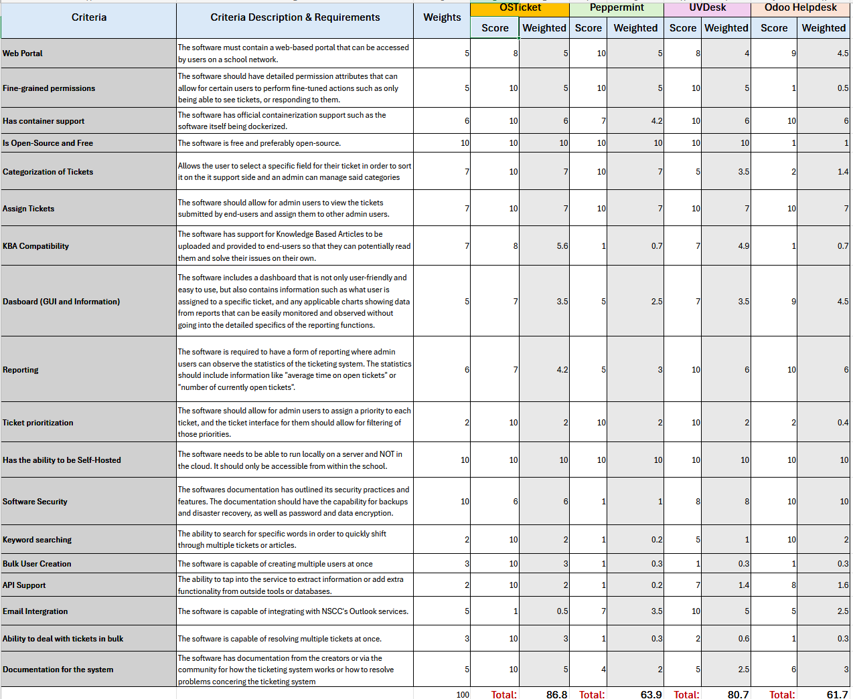
Weighted Evaluation
Notes:
Via weighted evaluation...
First set of candidates...

Slide 9
Three candidates
OSTicket
Zammad
Django-Helpdesk
A ticketing system that meets most of the requirements with a slightly outdated UI design. It is still currently being updated as of February 2025.
A modern ticketing system that covers all the must have and nice to have requirements without being overwhelming. The company behind the system is a non-profit that focuses on providing the best product for modern browsers.
Lightweight and developer-friendly system best suited for teams comfortable with Python.

Slide 10
OSTicket
A simple and open-source ticketing platform available for self-hosting.

Slide 11
Does it meet Requirements?
Must Have
Nice to Have
Container Support
Free (Open Source)
Self-Hosted
Categorization of Tickets
KBA Support
Dashboard
Reporting
Prioritization
Security
Fine-grained Permission assigning
Keyword Searching
Bulk User creation
API Support
Email Integration
Official Documentation
Non limiting caps (for users, tickets, etc.)
Bulk Ticket resolution

Slide 12
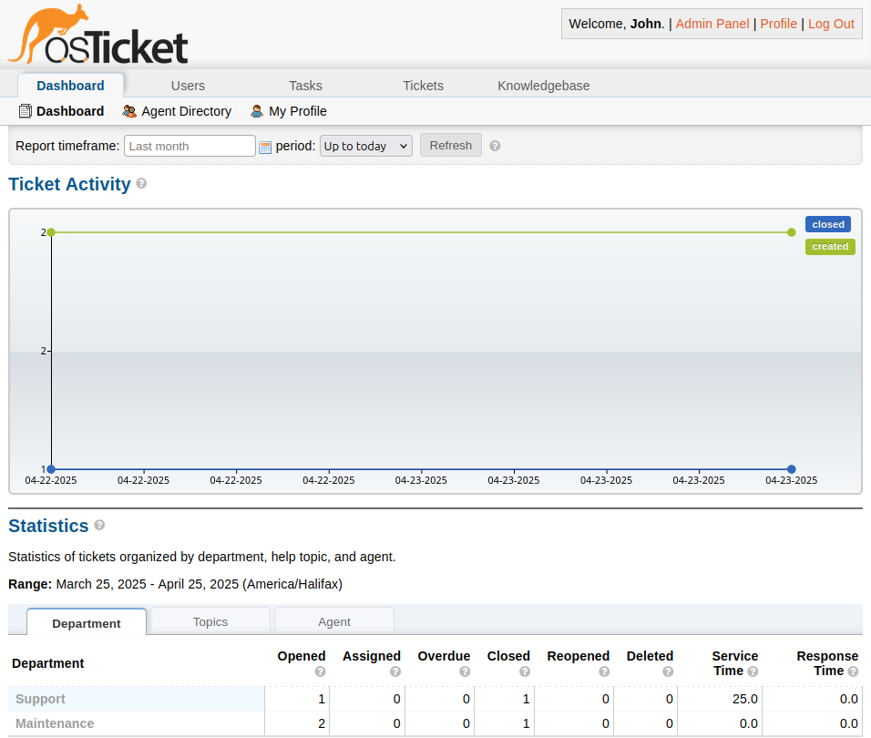
Dashboard
All images are derived from OSTicket web portal.

Slide 13
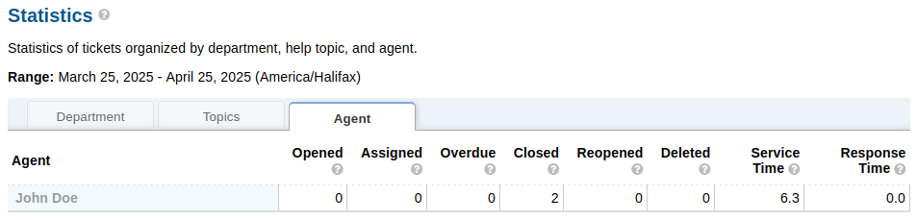

reporting
All images are derived from OSTicket web portal.

Slide 14
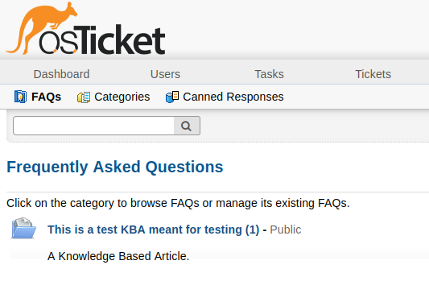
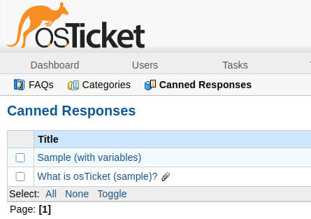
KBA Support
All images are derived from OSTicket web portal.

Slide 15
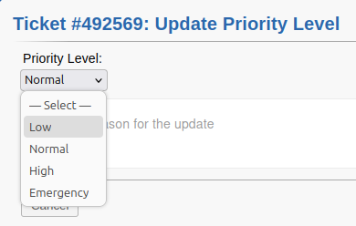
Prioritization
All images are derived from OSTicket web portal.

Slide 16
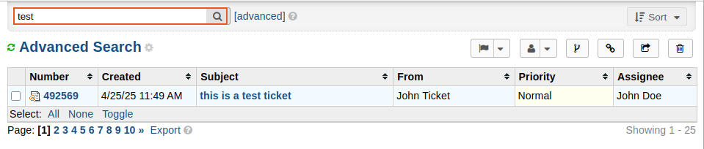
Keyword Searching
All images are derived from OSTicket web portal.

Slide 17
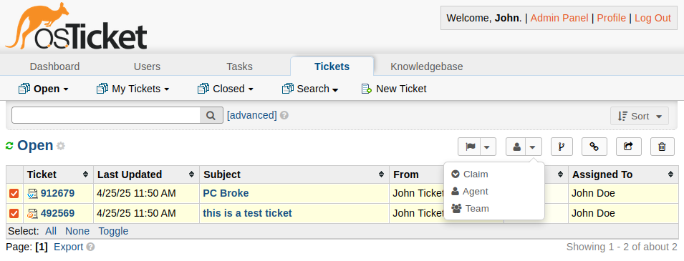
BULK Ticket Resolution
The following options are available for tickets:
Change status
Assign
Merge
Link
Transfer
Delete
All images are derived from OSTicket web portal.

Slide 18
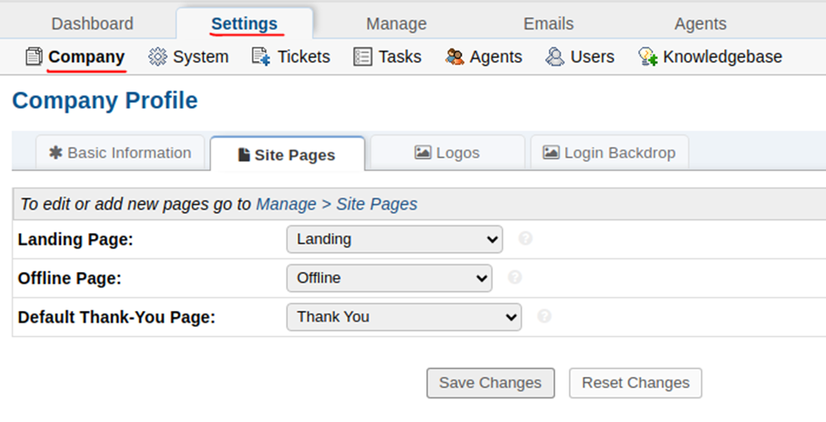
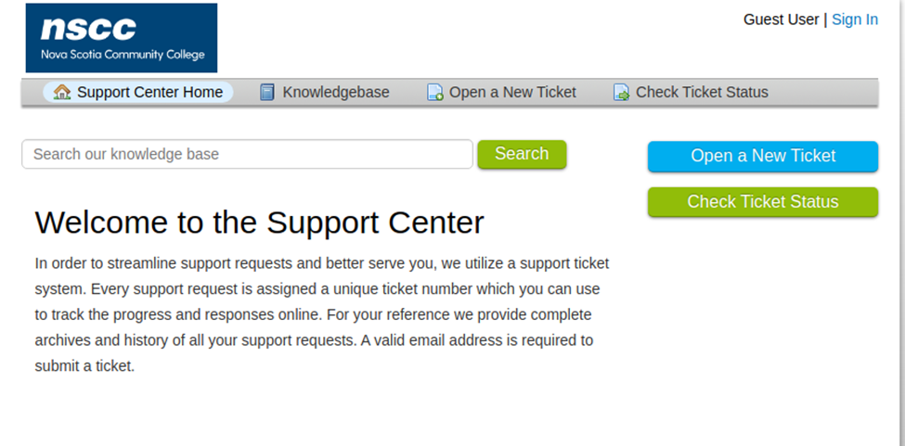
Branding/ Customization
Customizable logos and backdrops that could be altered to fit with NSCC.

Slide 19
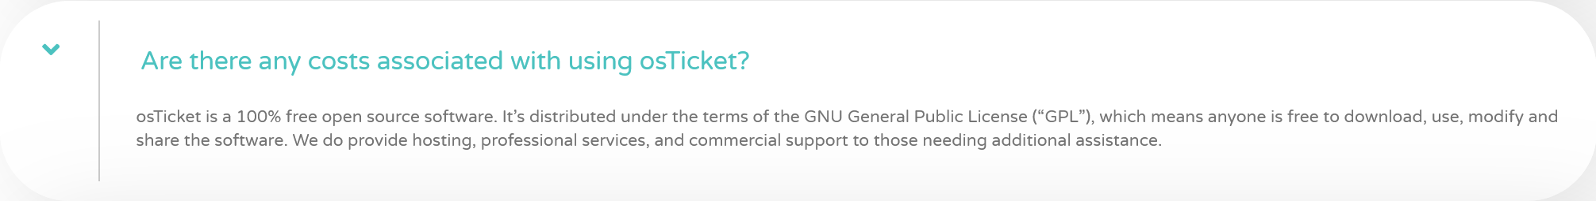
Licensing
Answer provided via OSTicket FAQ page: https://osticket.com/faq/

Slide 20
Zammad
Modern, fully integrated support platform with a polished UI.

Slide 21
Requirements
Must Have
Nice to Have
Container Support
Free (Open Source)
Self-Hosted
Categorization of Tickets
KBA Support
Dashboard
Reporting
Prioritization
Security
Fine-grained Permission assigning
Keyword Searching
Bulk User creation
API Support
Email Integration
Official Documentation
Non limiting caps (for users, tickets, etc.)
Bulk Ticket resolution

Slide 22
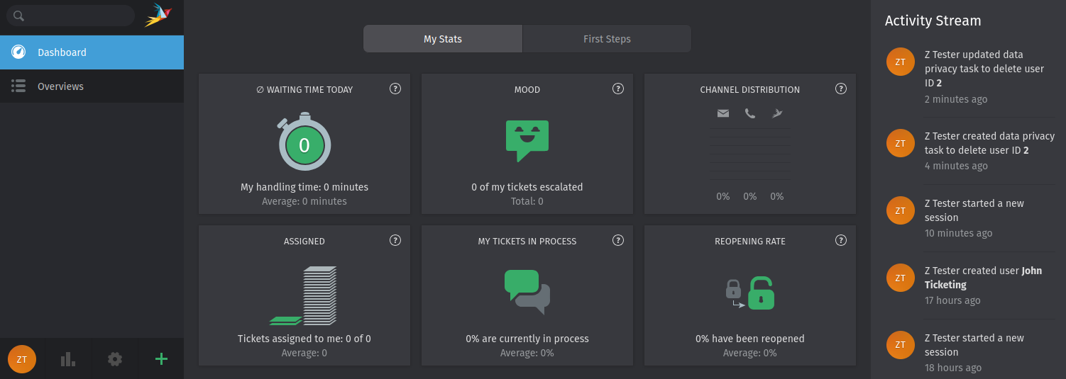
Dashboard
All images are derived from Zammad Helpdesk.

Slide 23
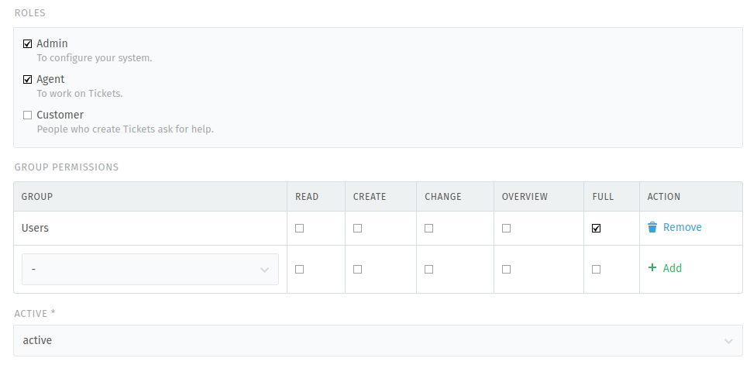
Fine-grained permissions
All images are derived from Zammad Helpdesk.

Slide 24
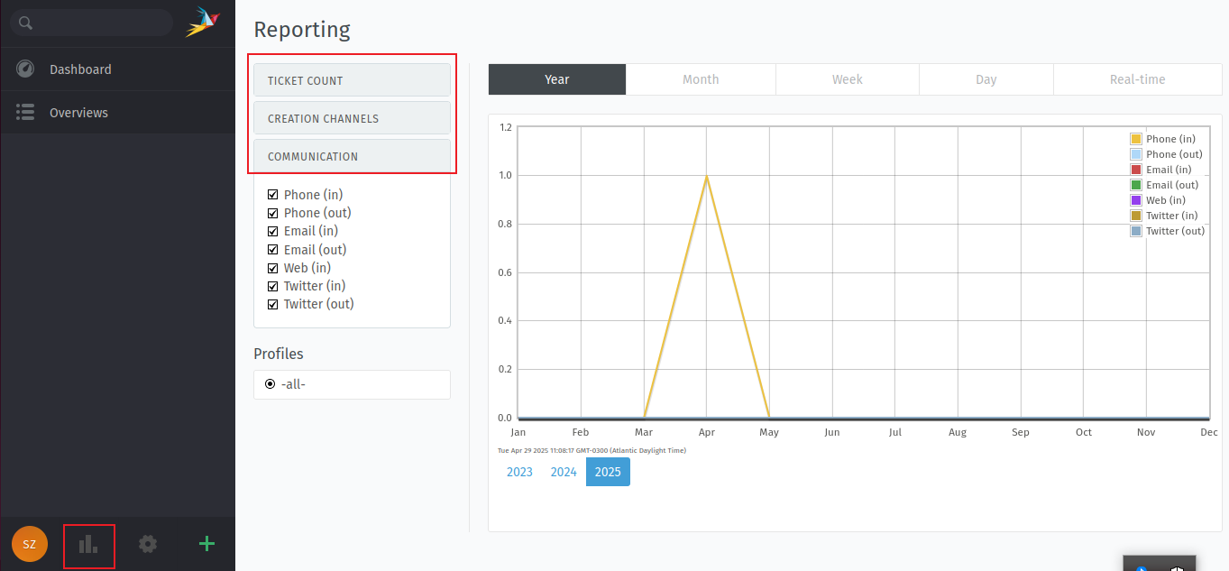
reporting
All images are derived from Zammad Helpdesk.

Slide 25
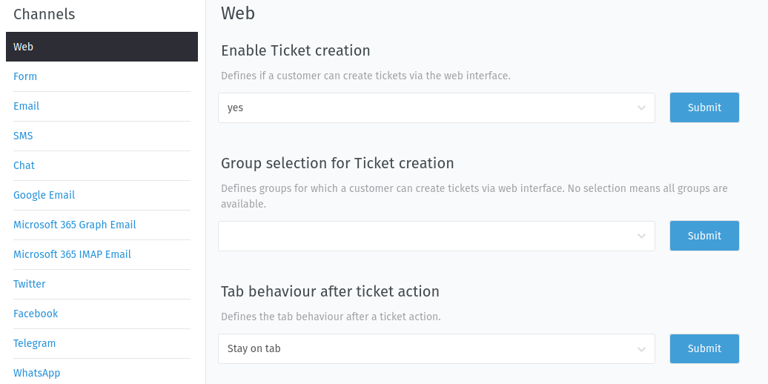
Channels
All images are derived from Zammad Helpdesk.

Slide 26
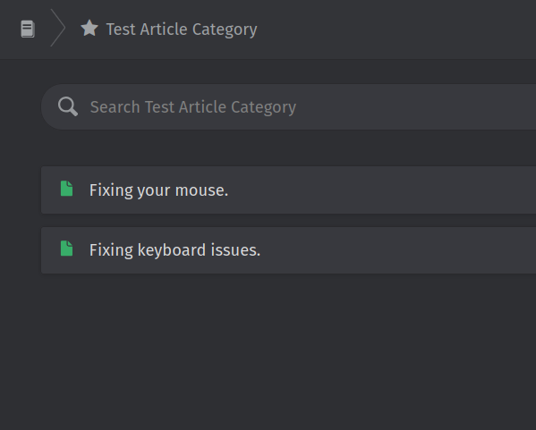
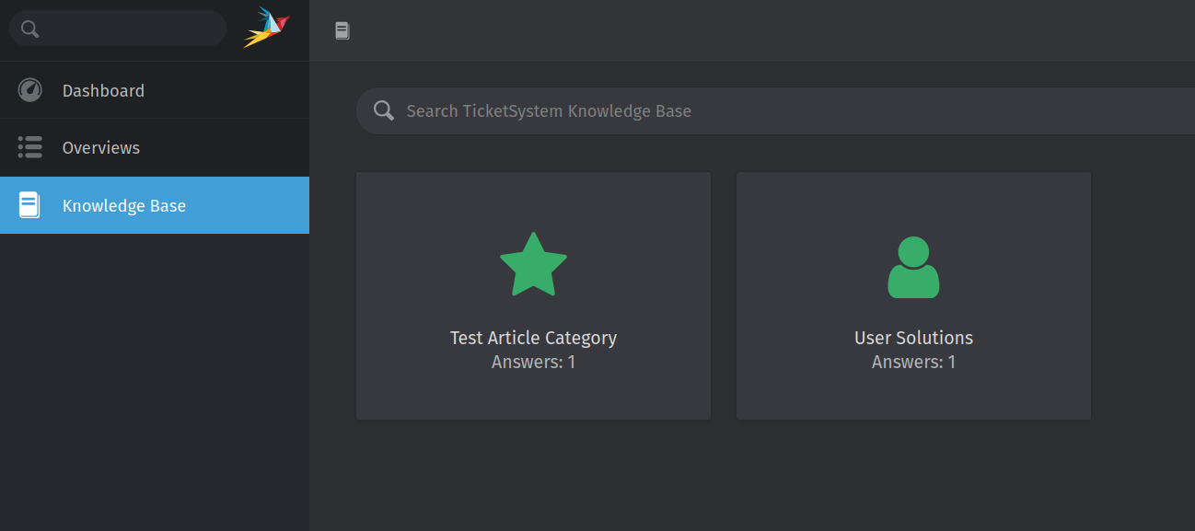
KBA Support
All images are derived from Zammad Helpdesk.

Slide 27
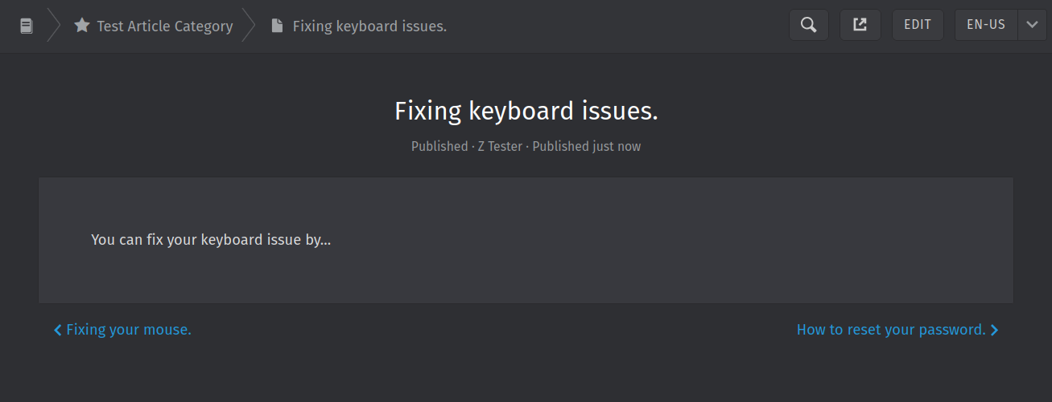
KBA Support
All images are derived from Zammad Helpdesk.

Slide 28
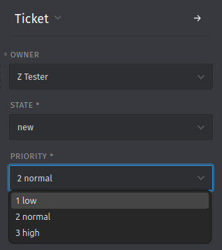
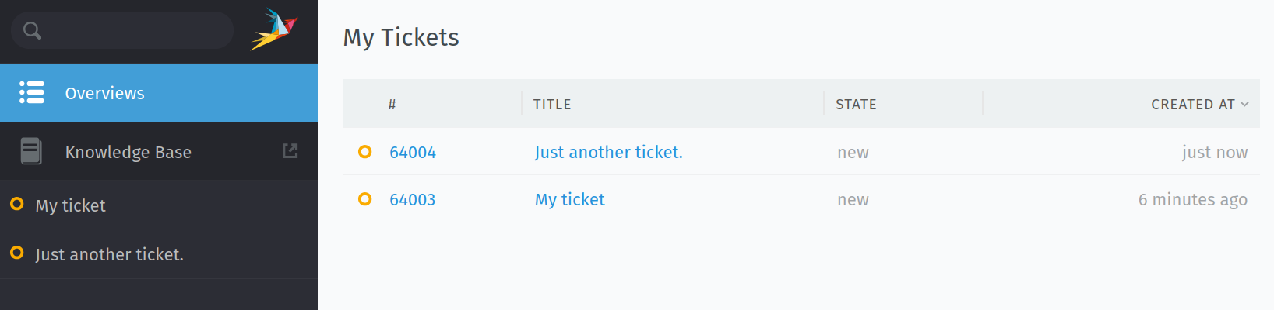
Tickets & Prioritization
End-user view.
All images are derived from Zammad Helpdesk.

Slide 29
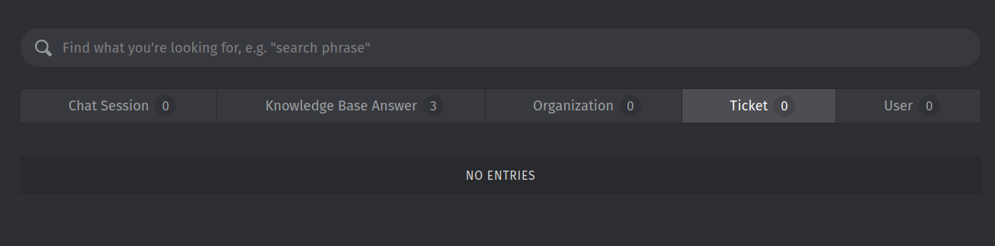
Keyword Searching
All images are derived from Zammad Helpdesk.

Slide 30
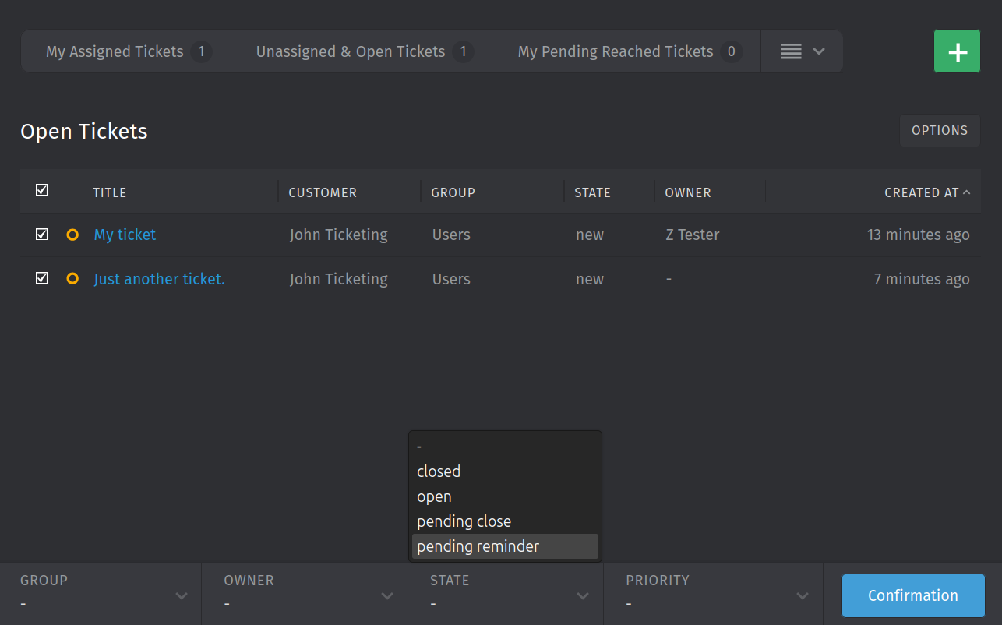
BULK Ticket Resolution
All images are derived from ….

Slide 31
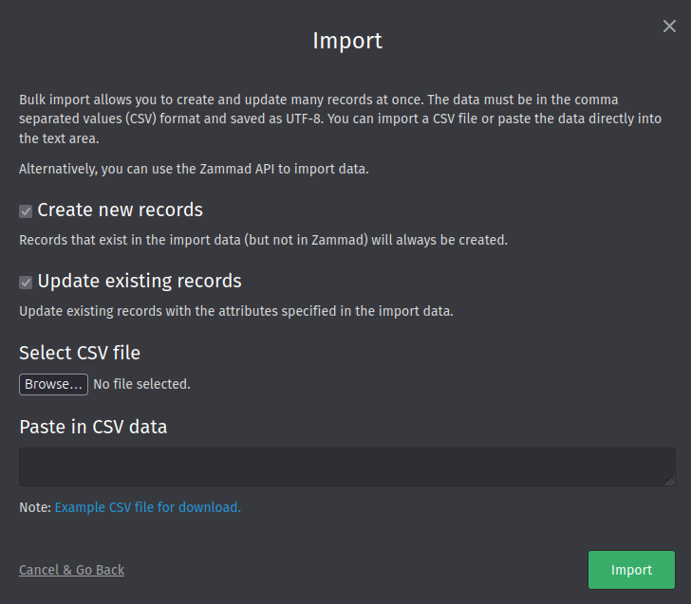
Bulk User Creation
All images are derived from Zammad Helpdesk.

Slide 32
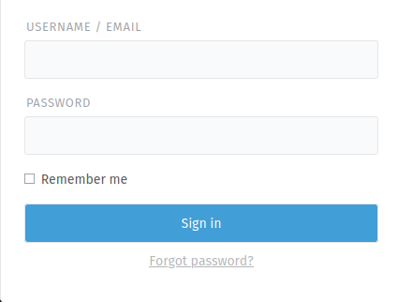
Branding/ Customization
Change Logo
Organization name
Product name

Slide 33
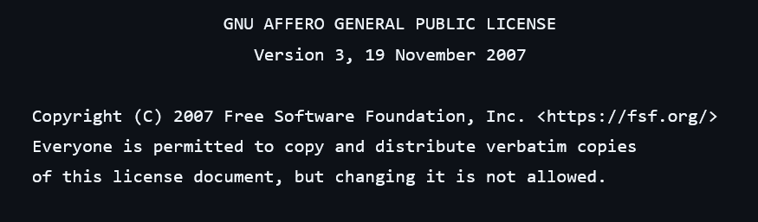
Licensing
Answer provided via Github Zammad repository: https://github.com/zammad/zammad/blob/develop/LICENSE

Slide 34
Django Helpdesk
Lightweight and developer-friendly system best suited for teams comfortable with Python.

Slide 35
Requirements
Must Have
Nice to Have
Container Support
Free (Open Source)
Self-Hosted
Categorization of Tickets
KBA Support
Dashboard
Reporting
Prioritization
Security
Fine-grained Permission assigning
Keyword Searching
Bulk User creation
API Support
Email Integration
Official Documentation
Non limiting caps (for users, tickets, etc.)
Bulk Ticket resolution

Slide 36
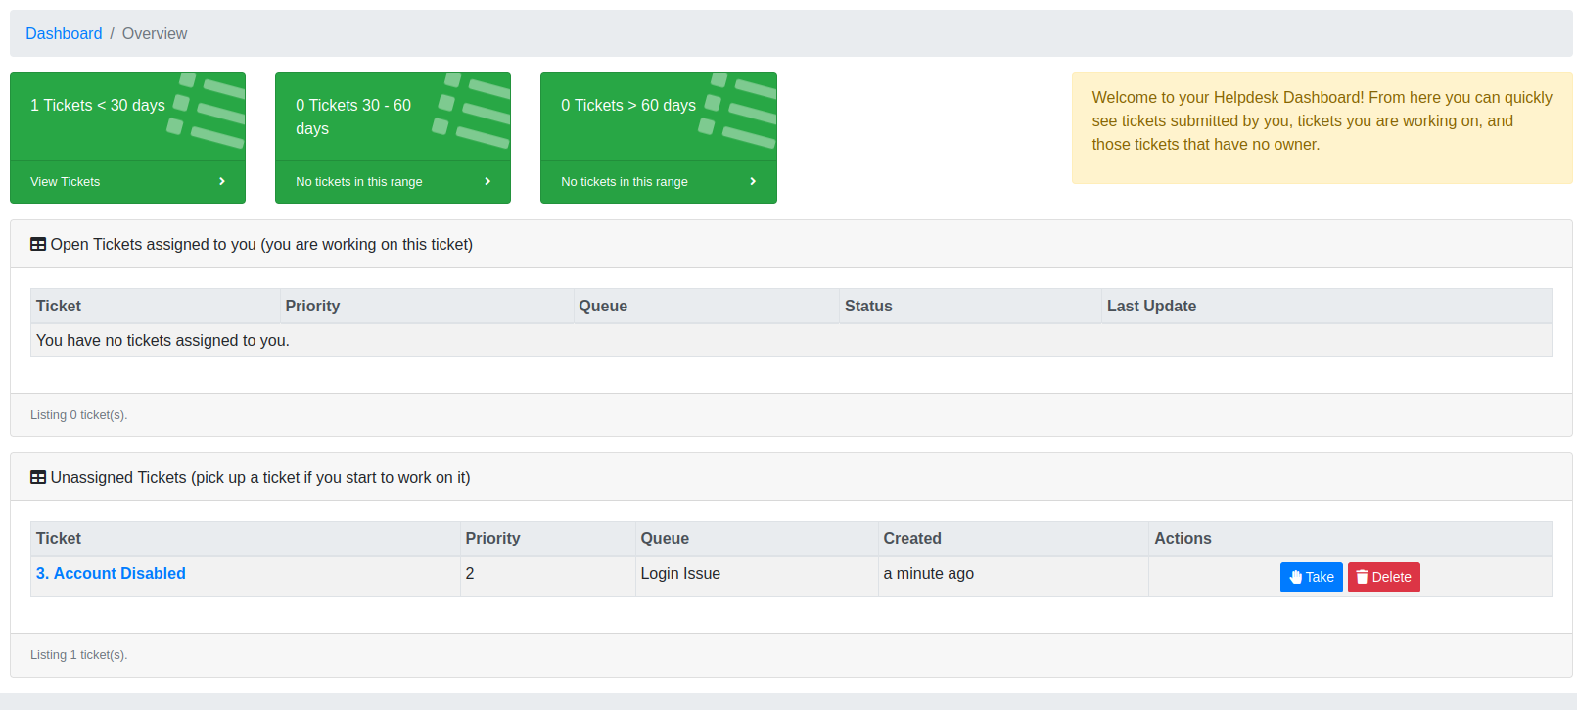
Dashboard
All images are derived from Django Helpdesk Web Portal

Slide 37
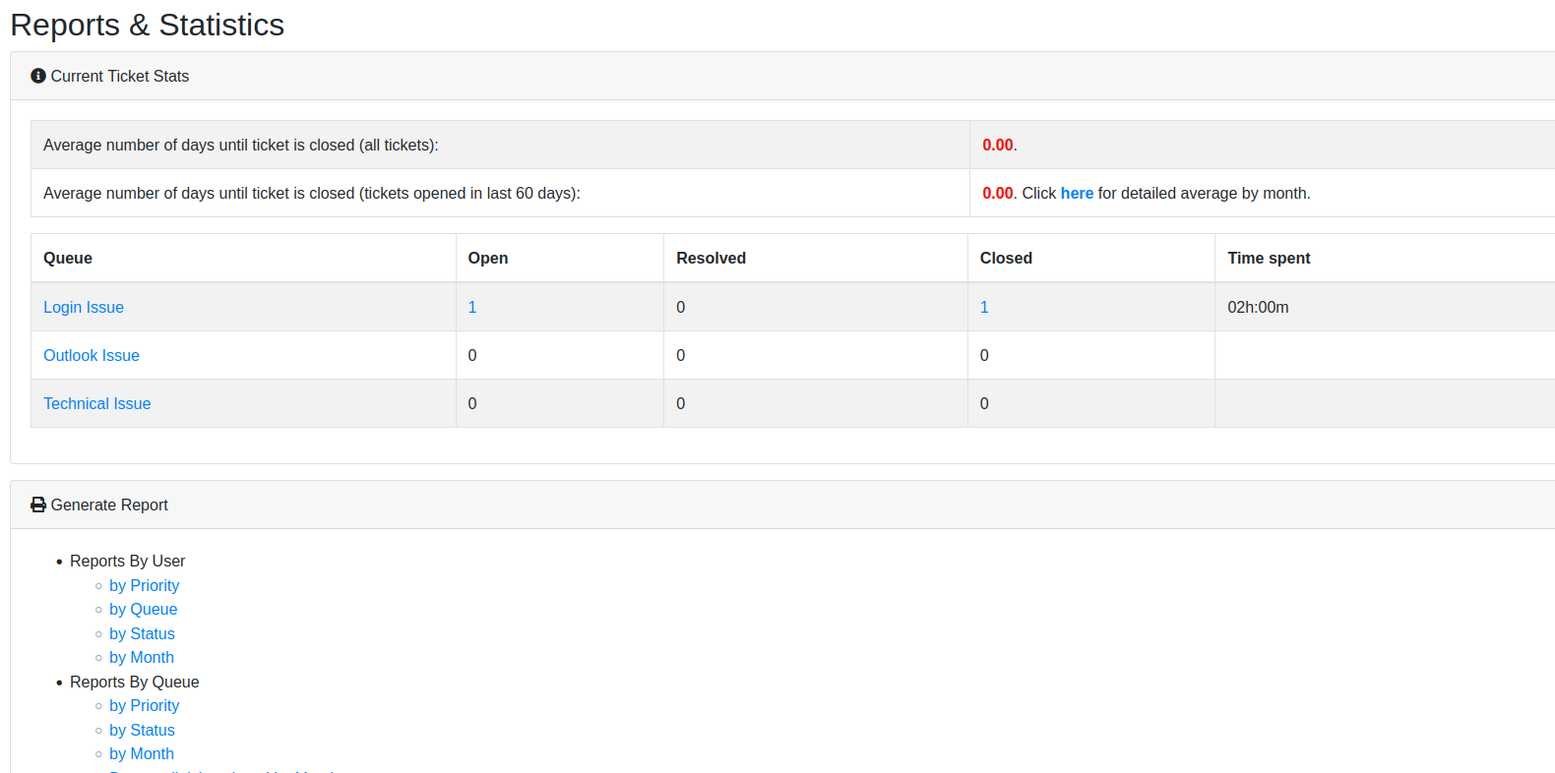
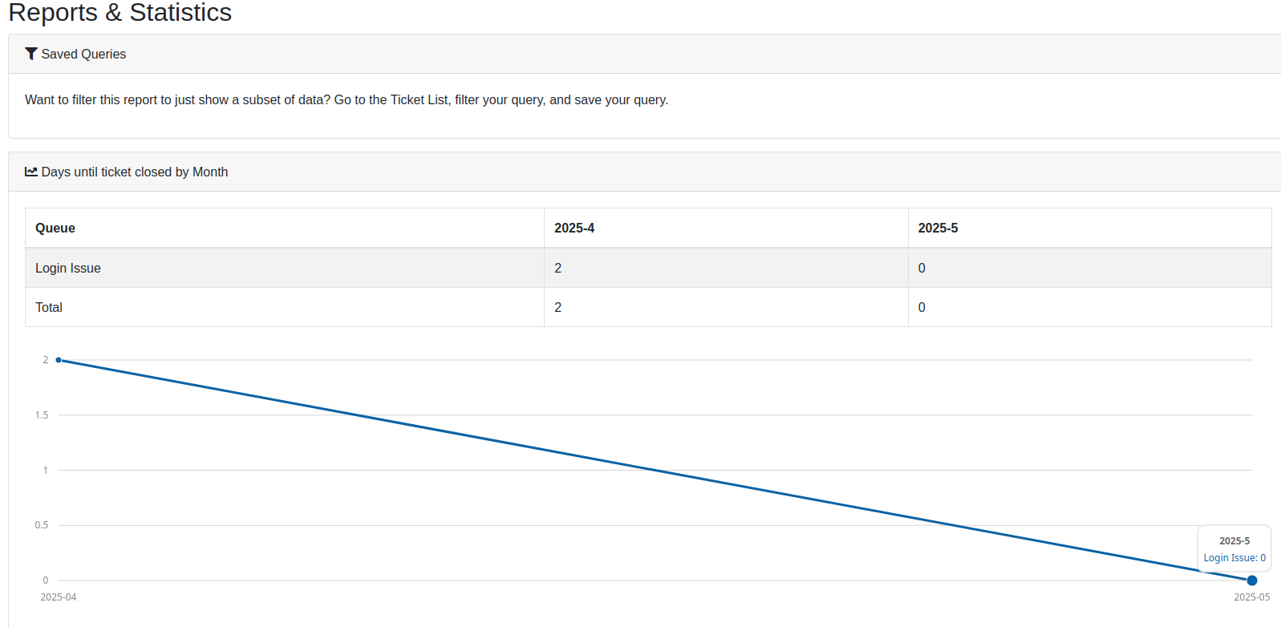
reporting
All images are derived from Django Helpdesk Web Portal

Slide 38
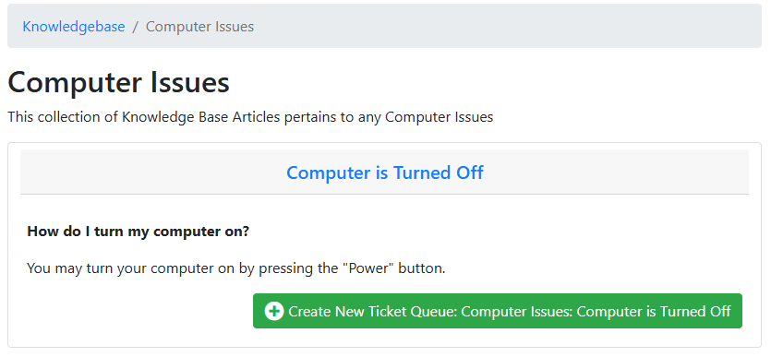
KBA Support
All images are derived from Django Helpdesk Web Portal

Slide 39
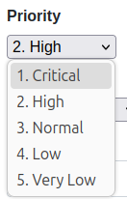
Prioritization
All images are derived from Django Helpdesk Web Portal

Slide 40
Keyword Searching
All images are derived from Django Helpdesk Web Portal

Slide 41
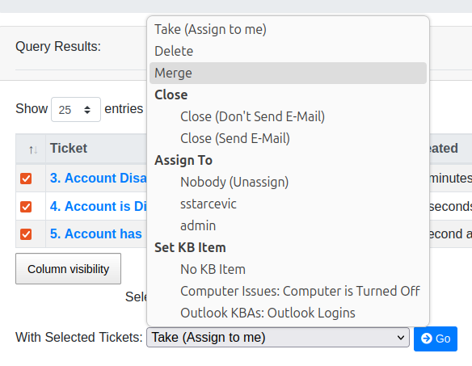
BULK Ticket Resolution
The following options are available for tickets:
Change status
Assign
Merge
Link
Transfer
Delete
All images are derived from Django Helpdesk Web Portal

Slide 42
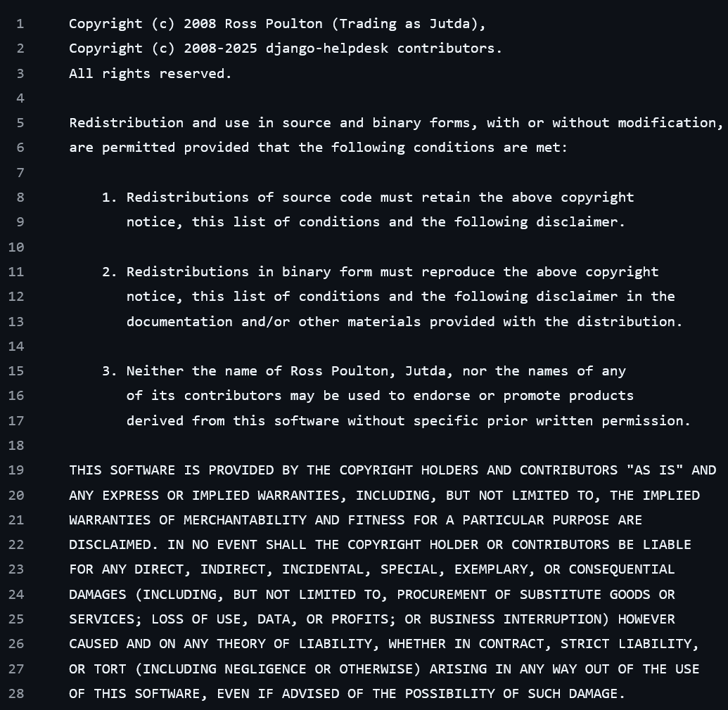
Licensing
Custom license following the open-source criteria with enforcement of original Copyright in product and no endorsements named to creators.
Provided via Django Helpdesk Github Repository, 2025;
https://github.com/django-helpdesk/django-helpdesk/blob/main/LICENSE

Slide 43
Recommendation
Django-Helpdesk
Zammad
OSTicket
Experience with Python, easy to setup.
Small team or Academic environment
Straight out of the box every requirement met
Designed around Modern software
Good scalability + usability
Good long-term support
Older reliable software with a good track record
Simpler set up for basic email functionality
Dedicated community for plugins, documentation, and forums

Slide 44
Up next
Developing documentation for possible system implementation
More research
Install plans
Security configuration planning
Disaster recovery and backup plans
Obtaining hardware
Testing plans
Knowledge based articles

